Slide 1
Telco Customer Churn
Aditya Bahl

Slide 2
Contents
Objective
1
Data Exploration
2
Segmentation
3
Insights & Recommendations
4
Results
5

Slide 3
Objective
Churn Customers - customers who cut ties with your service or company
Cost of Acquiring New Customers >>> Retaining Old Customers
Predict churn customers and churn cause and handle churn

Slide 4
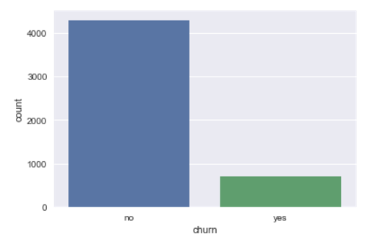
Data Exploration
5000 Customers
707 customers churn
Imbalanced Dataset

Slide 5
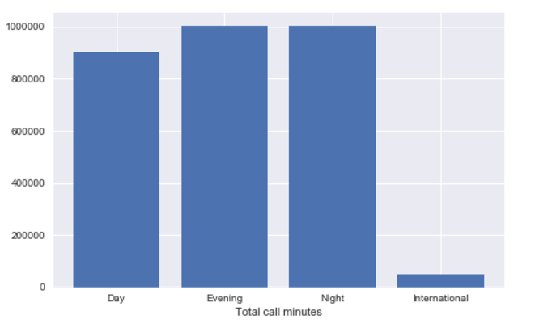
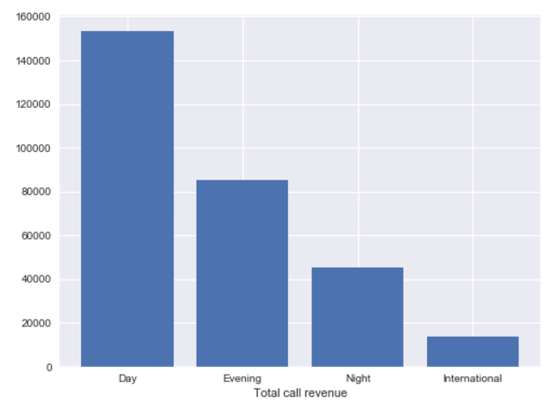
Customer Usage details

Slide 6
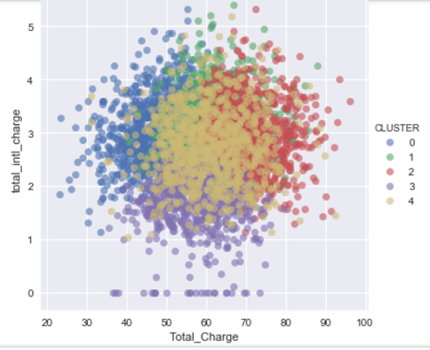
Customer Segmentation
K Means Clustering Algorithm
5 Customer segments based on usage
For each segment
Decision Tree Model - Why customer churns ?
Random Forest Model – Which customer churns ?

Slide 7
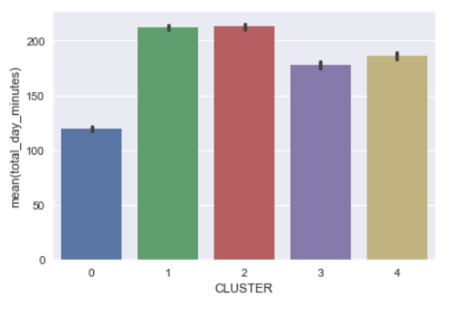
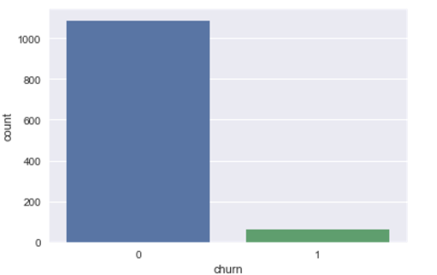
Segment 1 – Low Day Users
Reasons for churn:
international plan and having total_intl_minutes > 13.0
international plan , having total_intl_minutes <= 13.0 and having total_intl_calls < 3
Recommendations:
Customers with high international usage offer free international minutes
Offer 5 free calls to customers with low international usage

Slide 8
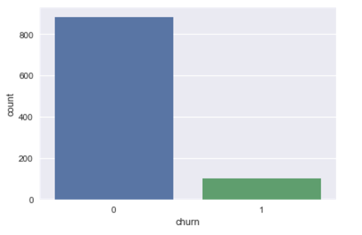
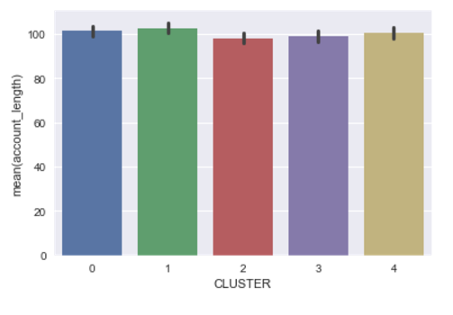
Segment 2 – Oldest Customers
Recommendations:
Offer day calling discounts to customers with Total charge > $73.97
Offer discounted international calling to Customers with total charge < $73.97
Reasons for Churn:
No international plan , with Total_Charge > $73.97 and day rate > $0.17
International plan , with Total_Charge <$73.97 & total_intl_charge > $3.535

Slide 9
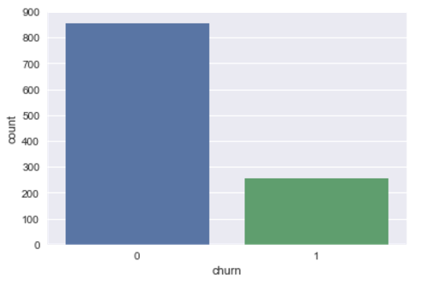
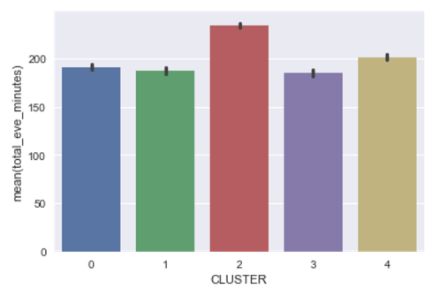
Segment 3 – Evening Users
Reasons for Churn:
Total charge greater than $74.23 with no Voicemail plan
Total charge less than $74.23 , having international plan but having total_intl_minutes > 13.0
Recommendations:
Offer discounted/free Voicemail plans for customers with Total Charge > $74.23
Offer free long duration international calls for customers with Total Charge < $74.23

Slide 10
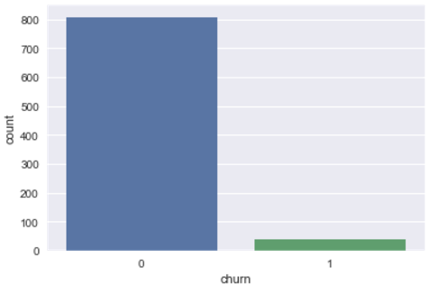
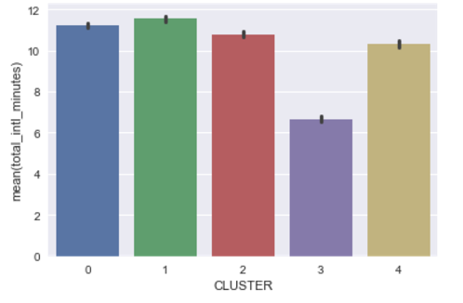
Segment 4 – Least Churn/Low International Callers
Reasons for Churn:
Total_Charge > $74.13, total_night_charge < $10.76
Total_Charge < $74.13 , having international plan but having total_intl_calls < 3
Recommendations:
Offer discounted day & eve call rates to customers with Total charge > $74.13
Offer 4 free international calls to customers with Total charge < $74.13

Slide 11
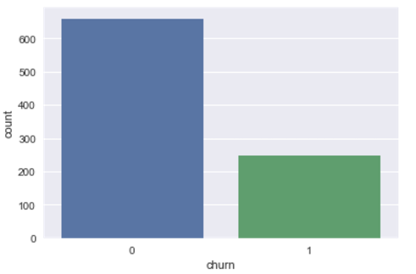
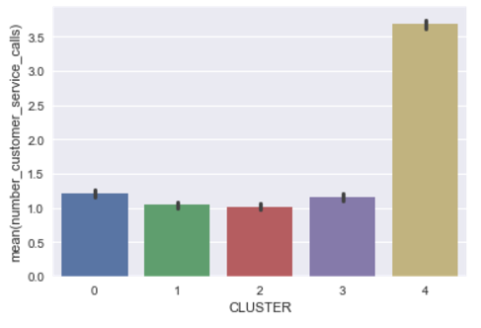
Segment 5 – Most Churn/CS Problems
Reasons for churn:
Number_customer_service_calls > 4 and Total_Charge <= $56.73
Number_customer_service_calls < 4 , Total_Charge > $73.92 and total_day_minutes <= 271.85
Recommendations:
Prioritized customer service to customers with Total_Charge < $56.73 based on customer value.
Offer free day minutes to customers with Total_Charge > $73.92 & total_day_minutes <= 271.85

Slide 12
Results
Potential Annual Revenue loss of $555693.6 averted
Predicted which customer churns and why
Provided targeted recommendations based on Machine Learning models for each customer segment

